Slide 1

BacChus Database Design
By The Space Unicorns
2/24/25

Slide 2

Meet The Team
Jason Luttrell
Anthony Nguyen
Andrew Estrada

Slide 3
Problem Description
Bachus Winery is looking to modernize legacy operations with a new approach to data management. The goal is to provide a database that enables future expansion into automated and online inventory tracking, ordering, and reporting.
The Minimum Viable Product provides a data structure that supports the long-term online functionality goals while delivering the automated reporting immediately.
Reporting should provide the health of the business, inventory, and workforce.

Slide 4
Business Rules
There are 28 employees (including the owners) who could be said to be assigned to the following departments:
Executive
Payroll and Finance
Marketing
Production
Distribution
Some employees report to others. Department leads may be said to report to the owners.
There are four type of wine produced, Merlot, Cabernet, Chablis and Chardonnay. But it should not be assumed that there will never be additional types added.
Currently each wine comes from one of three or more types of grapes, Merlot, One or more varieties of Cabernet, and Chardoney.
There can be more than one grape variety used on a wine.
Each wine bottle comes from one and only one batch, each batch comes from one or more grapes from one and only one year. Each batch has one and only one wine variety

Slide 5
Business Rules Continued
Each wine variety is graded for quality for each year.
There are supplies associated with the wine production and suppliers who provide the supplies. There can be one or more suppliers for each product. There can be one or more products for each supplier.
There is an inventory associated with each product and a reorder amount for each product. There can also be some number of products that are ordered but not delivered. There can be a typical order quantity associated with an order. There needs to be an expected delivery date (at time of order) for each order, and a date received for each order.
Distributors sell the wine. A distributor order needs to be tracked as well, with an order status field, wine product, Qty, Date ordered, delivery expected date, delivered date, One order can have multiple products.
Employees need to track time and pay, with date worked, hours worked, pay rate, with salary and hourly worker functionality

Slide 6

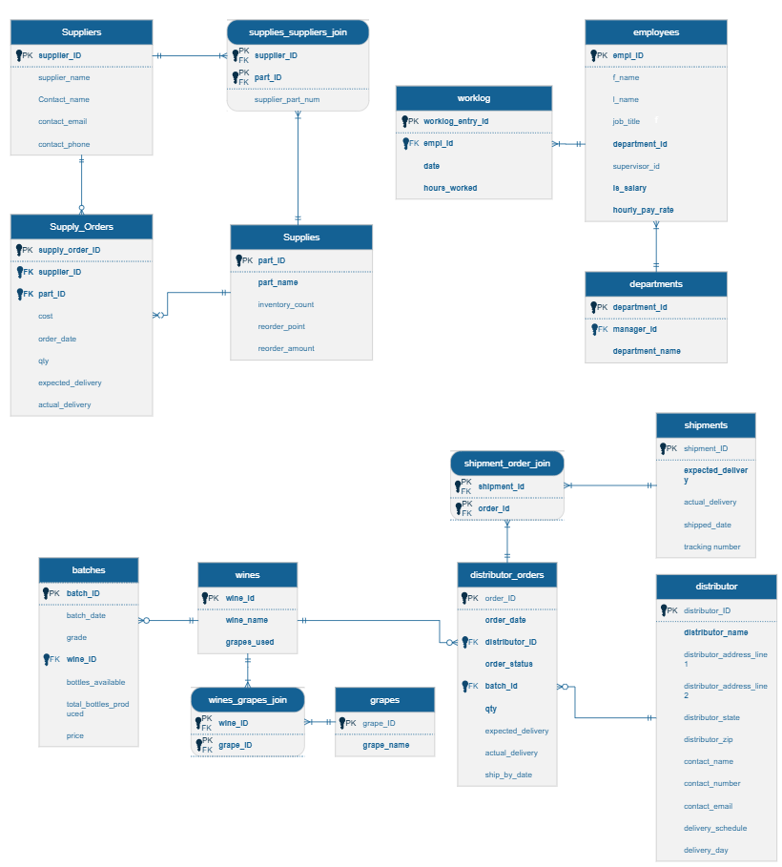
ERD The following three slides will present enlarged partial views of the ERD
C

Slide 7
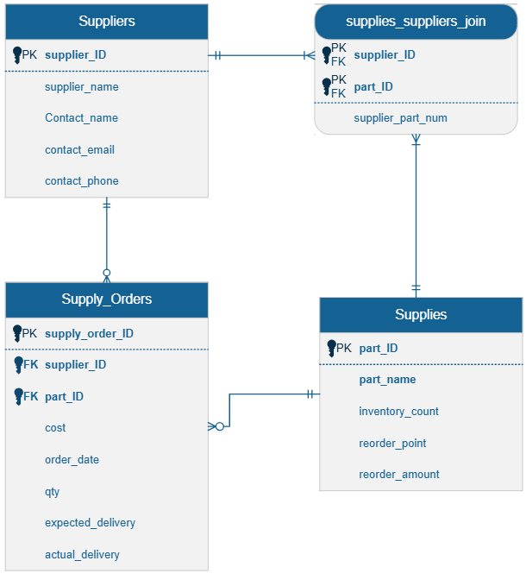
ERD Supplies
The separation of supplies into a separate table from supply orders, along with the use of a part_ID separate from the suppliers part number allows for the database to handle multiple suppliers with the same part.
Supplier part numbers are associated with internal part numbers through the join table.
Internal business rules, especially as a result of a LEAN inventory analysis can govern reorder points and nightly reports can serve as KANBAN triggers for manual or automated reorder.
Attaching actual and expected delivery dates, along with cost in the Supply_Orders tables creates structure that enables real time decision making on preferred suppliers for particular parts, or tracking trends over time.
The inventory count feature requires either an automated inventory tracking system or manual updates via a GUI. This feature is not required and can be leveraged when the company is ready to create the supporting process(es).
The supplies_suppliers_join and Supplies tables create a more sophisticated structure that does not need to be leveraged initially. The company can grow into a more sophisticated use of these tables over time, with at least two phases of implementation without the need to updated the database structure.

Slide 8
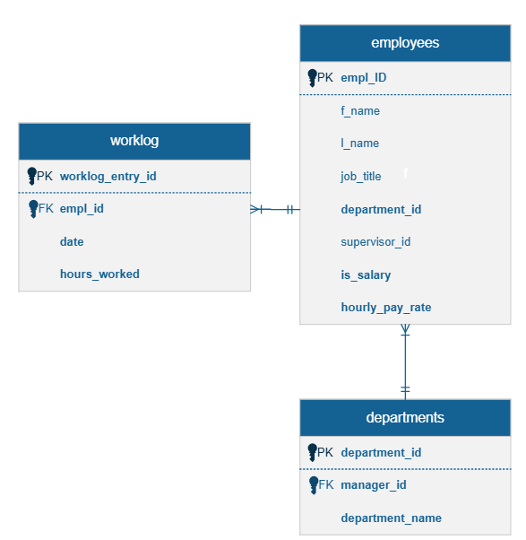
ERD People
The People Data in this database strikes a balance between detailed data and simplicity for reporting.
The employees table has an hourly pay rate field that can be used for both salaried and hourly employees using an assumption of 40 hour weeks for salaried personnel. The is_salary field is a Boolean and identifies the employee’s pay type status. This way the company can handle three pay scenario’s based on business practices:
Hourly workers can be paid regular and overtime based on automated reporting.
Salary non-exempt workers can also track hours and be paid overtime for hours worked in accordance with the law.
Salary exempt workers can track hours and internal policy decisions can be made as to how to handle any overtime or compensatory benefits as the company see fit.

Slide 9
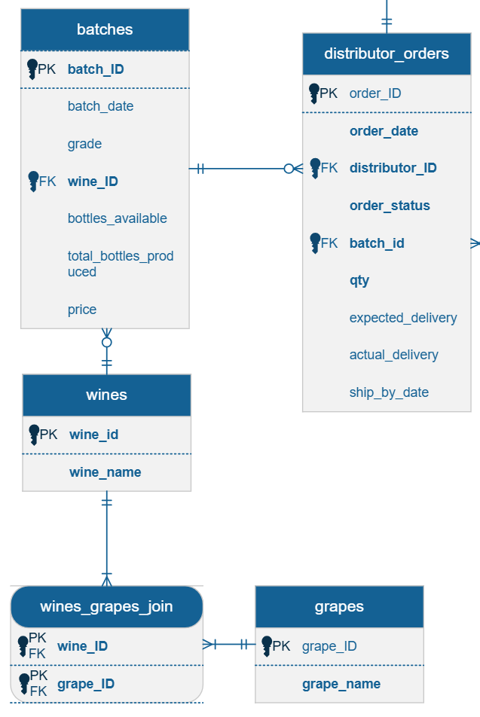
ERD Product
The product section of the ERD provides functionality for the complex relationships between wines, years and batches.
As each year and each batch can vary in quality, there can be significant price difference, demand fluctuations and inventory levels on the same labels and wine types.
Batched based reporting can be done by wine, year, price, available inventory, yield and grade. With these features, advanced price and profit models and forecasts can be generated in an analytics platform to help drive strategy from growing through production and sales.
The use of a grapes table allows for blends to be produced and tracked without any updates to the database.
The association of orders to batches, along with a running inventory supports future plans to automate ordering through a web portal.

Slide 10
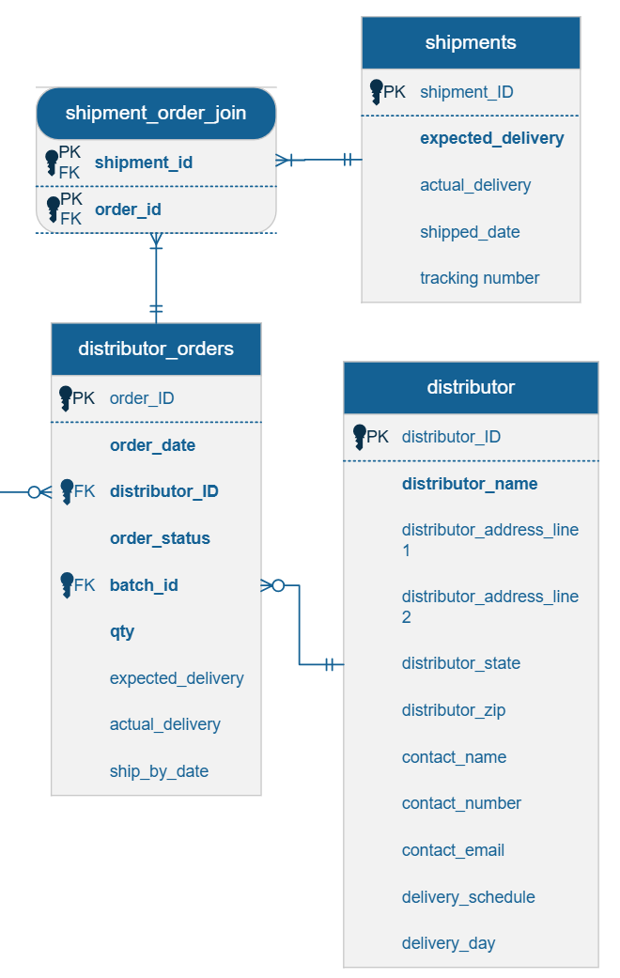
ERD Sales
The sale section of the ERD helps track sales from order through delivery and provides the necessary structure for online ordering and strategic fulfillment.
Separating distributor orders by product allows the business to track fulfillment individually without having to worry about parts of orders being delayed. This mimics the data structure for major online retailers like Amazon.
The distributor can set default shipping preferences in the delivery schedule and delivery day fields. If desired a distributor can receive deliveries as soon as possible or every two weeks on Thursdays. The shipping department can run automated reports that trigger shipment pooling and ship dates according to those preferences.
Like the supplies group, expected and actual delivery dates allow reporting on shipping performance over time, by any of a number of variables.
Order details like date and quantity allow the company to profile their suppliers by time, order size, or order frequency

Slide 11
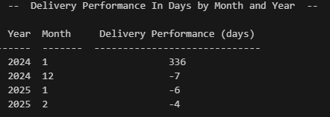
Report 1 of 3
The Delivery Performance In Day By Month and Year
Shows an average of the days late of all deliveries for a particular month
Positive numbers indicate the average is late
Negative numbers indicate the average is early
Sorted from earliest to latest month

Slide 12
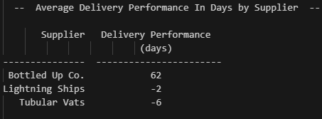
Report 2 of 3
Average Delivery Performance In Days by Supplier
Same information as the monthly report but by supplier
Allows the user to identify problem suppliers
Sorted by average days in descending order

Slide 13
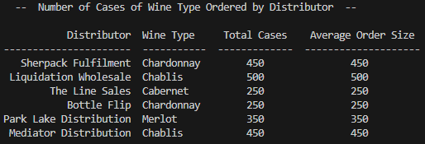
Report 3 of 3
Number of Cases of Wine Type Ordered by Distributor
Lists each distributor and the number of cases of each wine type that they order, and the average size of orders*.
If a distributor orders multiple types, there will be multiple rows for that distributor
*The sample data only has one order per distributor, so in the sample report average order is the same as Total Cases

Slide 14

Assumptions
Owners would be in an executive department and one owner would be the nominal manager of that department
Reorder quantities would be identified for each reorder part
Salaried employee compensation rates would be calculated hourly based on a 40 hour work week and 52 weeks a year
Salaried employees would be automatically logged as working a 40 hour week for payroll purposes.
One grape goes to one wine
All batches would be graded and priced individually
Orders would contain only 1 type of wine each.
Smallest order quantity is 1 case
Reporting will primarily be done by an analytics platform like Power BI or Tableau. Sample reports provided in this presentation are proofs of concept and can be used early in the implementation process while more robust business reporting is implemented.

Slide 15
Contact us
C
Starfieldoffice@spaceunicorns.com

